Slide 1
IV054
RSA Cryptosystem
The most important public-key cryptosystem is the RSA cryptosystem on which one can also illustrate a variety of important ideas of modern public-key cryptography.
A special attention will be given to the problem of factorization of integers that play such an important role for security of RSA.
Several factorization methods will be presented and discuss. In doing that we will illustrate modern distributed techniques to factorize very large integers.
For example we will discuss various possible attacks on the RSA
cryptosystem and various other problems related to security of the
RSA cryptosystems.
RSA cryptosystem

Slide 2



IV054
DESIGN and USE of RSA CRYPTOSYSTEM
Invented in 1978 by Rivest, Shamir, Adleman
Basic idea: prime multiplication is very easy, integer factorization seems to be unfeasible.
Design of RSA cryptosystems
Choose two large (512 - 1024 bits) primes p,q and denote
Choose a large d such that
and compute
Public key: n (modulus), e (encryption algorithm)
Trapdoor information: p, q, d (decryption algorithm)
Plaintext w
Encryption: cryptotext c = w^{e} mod n
Decryption: plaintext w = c^{d} mod n
Details: A plaintext is first encoded as a word over the alphabet {0, 1,…,9}, then divided into blocks of length i -1, where 10 ^{i-1} < n < 10 ^{i}. Each block is taken as an integer and decrypted using modular exponentiation.
RSA cryptosystem

Slide 3
IV054
DESIGN and USE of RSA CRYPTOSYSTEM
Example of the design and of the use of RSA cryptosystems.
By choosing p = 41,q = 61 we get n = 2501, φ(n) = 2400
By choosing d = 2087 we get e = 23
By choosing d = 2069 we get e=29
By choosing other values of d we get other values of e.
Let us choose the first pair of encryption/decryption exponents ( e=23 and d=2087).
Plaintext: KARLSRUHE
Encoding: 100017111817200704
Since 10³ < n < 10⁴, the numerical plaintext is divided into blocks of 3 digits ⇒ 6 plaintext integers are obtained
100, 017, 111, 817, 200, 704
Encryption:
100²³ mod 2501, 17²³ mod 2501, 111²³ mod 2501
817²³ mod 2501, 200²³ mod 2501, 704²³ mod 2501
provides cryptotexts: 2306, 1893, 621, 1380, 490, 313
Decryption:
2306 ²⁰⁸⁷ mod 2501 = 100, 1893 ²⁰⁸⁷ mod 2501 = 17
621 ²⁰⁸⁷ mod 2501 = 111, 1380 ²⁰⁸⁷ mod 2501 = 817
490 ²⁰⁸⁷ mod 2501 = 200, 313 ²⁰⁸⁷ mod 2501 = 704
RSA cryptosystem

Slide 4




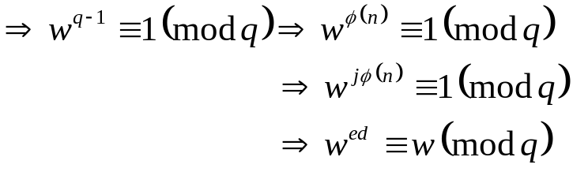

IV054
Correctness of RSA
Let c = w^{e} mod n be the cryptotext for a plaintext w, in the cryptosystem with
In such a case
and, if the decryption is unique, w = c^{d} mod n.
Proof Since , there exist a j € N such that
Case 1. Neither p nor q divides w.
In such a case gcd(n, w) = 1 and by the Euler's Totien Theorem we get that
Case 2. Exactly one of p,q divides w - say p.
In such a case w^{ed} ≡ w (mod p) and by Fermat's Little theorem w^{q-1} ≡ 1 (mod q)
Therefore:
Case 3 Both p,q divide w.
This cannot happen because, by our assumption, w < n.
RSA cryptosystem

Slide 5
IV054
RSA challenge
One of the first description of RSA was in the paper.
Martin Gardner: Mathematical games, Scientific American, 1977
and in this paper RSA inventors presented the following challenge.
Decrypt the cryptotext:
9686 9613 7546 2206 1477 1409 2225 4355 8829 0575 9991 1245 7431 9874 6951 2093 0816 2982 2514 5708 3569 3147 6622 8839 8962 8013 3919 9055 1829 9451 5781 5154
Encrypted using the RSA cryptosystem with
n: 114 381 625 757 888 867 669 235 779 976 146 612 010 218 296 721 242 362 562 561 842 935 706 935 245 733 897 830 597 123 513 958 705 058 989 075 147 599 290 026 879 543 541.
and with e = 9007
The problem was solved in 1994 by first factorizing n into one 64-bit prime and one 65-bit prime, and then computing the plaintext
THE MAGIC WORDS ARE SQUEMISH OSSIFRAGE
RSA cryptosystem

Slide 6
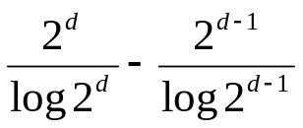
IV054
How to design a good RSA cryptosystem
1. How to choose large primes p,q?
Choose randomly a large integer p, and verify, using a randomized algorithm, whether p is prime. If not, check p + 2, p + 4,…
From the Prime Number Theorem if follows that there are approximately
d bit primes. (A probability that a 512-bit number is prime is 0.00562.)
2. What kind of relations should be between p and q?
2.1 Difference |p-q| should be neither too small not too large.
2.2 gcd(p-1, q-1) should not be large.
2.3 Both p-1 and q-1 should contain large prime factors.
2.4 Quite ideal case: q, p should be safe primes - such that also (p–1)/2 and (q-1)/2 are primes (83,107,10¹⁰⁰ – 166517 are examples of safe primes).
3. How to choose e and d?
3.1 Neither d nor e should be small.
3.2 d should not be smaller than n^{1/4}. (For d < n^{1/4} a polynomial time algorithm is
known to determine d.
RSA cryptosystem

Slide 7






IV054
DESIGN OF GOOD RSA CRYPTOSYSTEMS
Claim 1. Difference |p-q| should not be small.
Indeed, if |p - q| is small, and p > q, then (p + q)/2 is only slightly larger than because
In addition is a square, say y².
In order to factor n it is then enough to test x > until such x is found that x² - n is a square, say y². In such a case
p + q = 2x, p – q = 2y and therefore p = x + y, q = x - y.
Claim 2. gcd(p-1, q-1) should not be large.
Indeed, in the opposite case s = lcm(p-1, q-1) is much smaller than If
then, for some integer k,
since p - 1|s, q - 1|s and therefore w^{k1s} ≡ 1 mod p and w^{ks+1} ≡ w mod q. Hence, d' can serve as a decryption exponent.
Moreover, in such a case s can be obtained by testing.
Question Is there enough primes (to choose again and again new ones)?
No problem, the number of primes of length 512 bit or less exceeds 10¹⁵⁰.
RSA cryptosystem

Slide 8
IV054
How important is factorization for breaking RSA?
If integer factorization is feasible, then RSA is breakable.
There is no proof that factorization is needed to break RSA.
If a method of breaking RSA would provide an effective way to get a trapdoor information, then factorization could be done effectively.
Theorem Any algorithm to compute φ(n) can be used to factor integers with the same complexity.
Theorem Any algorithm for computing d can be converted into a break randomized algorithm for factoring integers with the same complexity.
There are setups in which RSA can be broken without factoring modulus n.
Example An agency chooses p, q and computes a modulus n = pq that is publicized and common to all users U₁, U₂ and also encryption exponents e₁, e₂,… are publicized. Each user U_{i} gets his decryption exponent d_{i}.
In such a setting any user is able to find in deterministic quadratic time another user's decryption exponent.
RSA cryptosystem

Slide 9
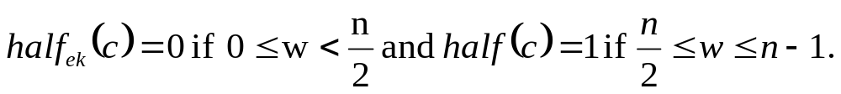
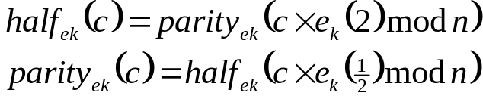
IV054
Security of RSA
None of the numerous attempts to develop attacks on RSA has turned out to be successful.
There are various results showing that it is impossible to obtain even only partial
information about the plaintext from the cryptotext produces by the RSA
cryptosystem.
We will show that were the following two functions, computationally
polynomially equivalent, be efficiently computable, then the RSA cryptosystem
with the encryption (decryption) algorithm e_{k} (d_{k}) would be breakable.
parity_{ek}(c) = the least significant bit of such an w that e_{k}(w) = c;
We show two important properties of the functions half and parity.
1. Polynomial time computational equivalence of the functions half and parity follows from the following identities
and the multiplicative rule e_{k}(w₁)e_{k}(w₂) = e_{k}(w₁w₂).
2. There is an efficient algorithm to determine plaintexts w from the cryptotexts c obtained by RSA-decryption provided efficiently computable function half can be used as the oracle:
RSA cryptosystem

Slide 10

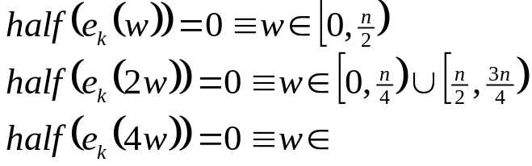
IV054
Security of RSA
BREAKING RSA USING AN ORACLE
Algorithm:
for i = 0 to [lg n] do
c _{i} ← half(c); c ← (c × e_{k}(2)) mod n
l ← 0; u ← n
for i = 0 to [lg n] do
m ← (l + u) / 2;
if c _{i} = 1 then l ← m else u ← m;
w ← [u]
Indeed, in the first cycle
is computed for 0 Ł i Ł lg n.
In the second part of the algorithm binary search is used to determine interval in which w lies. For example, we have that
RSA cryptosystem

Slide 11
IV054
Security of RSA
There are many results for RSA showing that certain parts are as hard as whole. For example any feasible algorithm to determine the last bit of the plaintext can be converted into a feasible algorithm to determine the whole plaintext.
Example Assume that we have an algorithm H to determine whether a plaintext x designed in RSA with public key e, n is smaller than n / 2 if the cryptotext y is given.
We construct an algorithm A to determine in which of the intervals (jn/8, (j +1)n/8), 0 Ł j Ł 7 the plaintext lies.
Basic idea H is used to decide whether the plaintexts for cryptotexts x^{e} mod n, 2ex^{e} mod n, 4ex^{e} mod n are smaller than n / 2 .
Answers
yes, yes, yes 0 < x < n/8 no, yes, yes n/2 < x < 5n/8
yes, yes, no n/8 < x < n/4 no, yes, no 5n/8 < x < 3n/4
yes, no, yes n/4 < x < 3n/8 no, no, yes 3n/4 < x < 7n/8
yes, no, no 3n/8 < x < n/2 no, no, no 7n/8 < x < n
RSA cryptosystem

Slide 12






IV054
RSA with a composite “to be a prime''
Let us explore what happens if some integer p used, as a prime, to design a RSA is actually not a prime.
Let n = pq where q be a prime, but p = p₁p₂, where p₁, p₂ are primes. In such a case
but assume that the RSA-designer works with
Let u = lcm(p₁ - 1, p₂ - 1, q -1) and let gcd(w, n) = 1. In such a case
and as a consequence
In such a case u divides and let us assume that also u divides
Then
So if e_{d} ≡ 1 mod φ₁(n), then encryption and decryption work as if p were prime.
Example p = 91 = 7 ·13, q = 41, n = 3731, φ₁(n) = 3600, φ(n) = 2880, lcm(6, 12, 40) = 120, 120|φ₁(n).
If gcd(d, φ₁(n)) = 1, then gcd(d, φ(n)) = 1 ⇒ one can compute e using φ₁(n). However, if u does not divide φ₁(n), then the cryptosystem does not work properly.
RSA cryptosystem

Slide 13







IV054
Two users should not use the same modulus
Otherwise, users, say A and B, would be able to decrypt messages of each other using the following method.
Decryption: B computes
Since
it holds:
and therefore
m and e_{A} have no common divisor and therefore there exist integers u, v such that
um + ve_{A} = 1
Since m is a multiple of φ(n) we have
and since e_{A}d_{A} ≡ 1 mod φ(n) we have
and therefore
is a decryption exponent of A. Indeed, for a cryptotext c:
RSA cryptosystem

Slide 14
IV054
Private-key versus public-key cryptography
The prime advantage of public-key cryptography is increased security - the private keys do not ever need to be transmitted or revealed to anyone.
Public key cryptography is not meant to replace secret-key cryptography, but rather to supplement it, to make it more secure.
Example RSA and DES are usually combined as follows
1. The message is encrypted with a random DES key
2. DES-key is encrypted with RSA
3. DES-encrypted message and RSA-encrypted DES-key are sent.
This protocol is called RSA digital envelope.
In software (hardware) DES is generally about 100 (1000) times faster than RSA.
If n users communicate with secrete-key cryptography, they need n (n - 1) / 2 keys. In the case they use public key cryptography 2n keys are sufficient.
Public-key cryptography allows spontaneous communication.
RSA cryptosystem

Slide 15
IV054
Private-key versus public-key cryptography
If RSA is used for digital signature then the public key is usually much smaller than private key => verification is faster.
An RSA signature is superior to a handwritten signature because it attests both to the contents of the message as well as to the identity of the signer.
As long as a secure hash function is used there is no way to take someone's signature from one document and attach it to another, or to after the signed message in any way.
The slightest change in a signed message will cause the digital signature verification process to fail.
Digital signature are the exact tool necessary to convert even the most important paper based documents to digital form and to have them only in the digital form.
RSA cryptosystem

